Slide 1
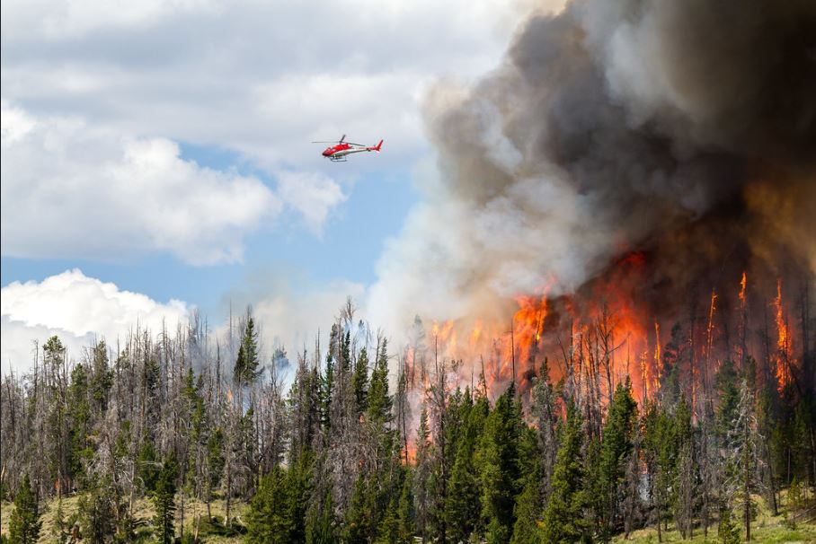

Wildfire Mitigation and Public Safety Power Shutoffs

Slide 2
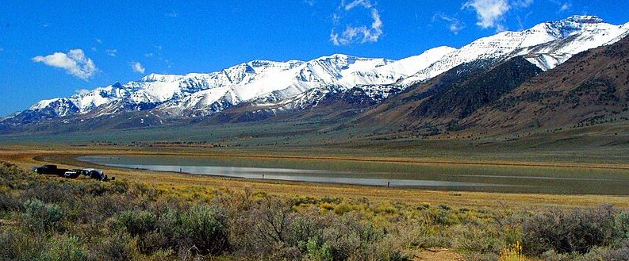

Eric Wirfs – Director of Operations
Shane Stenquist – Manager of Communications

Slide 3
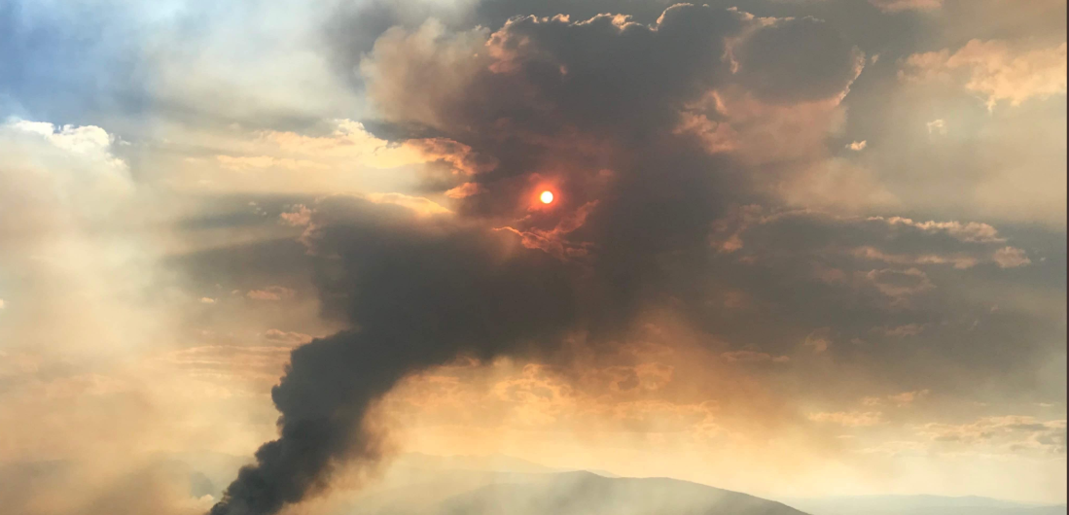

Safety Share
Over 85% of Wildfires are human-caused
If camping, keep campfire in open location and far from flammables. Douse campfire until cold
Keep vehicles off dry grass. Check tires, bearings and axles on trailers
Never operate equipment that produce sparks near dry vegetation
Use caution when burning debris, pay attention to local fire restrictions

Slide 4
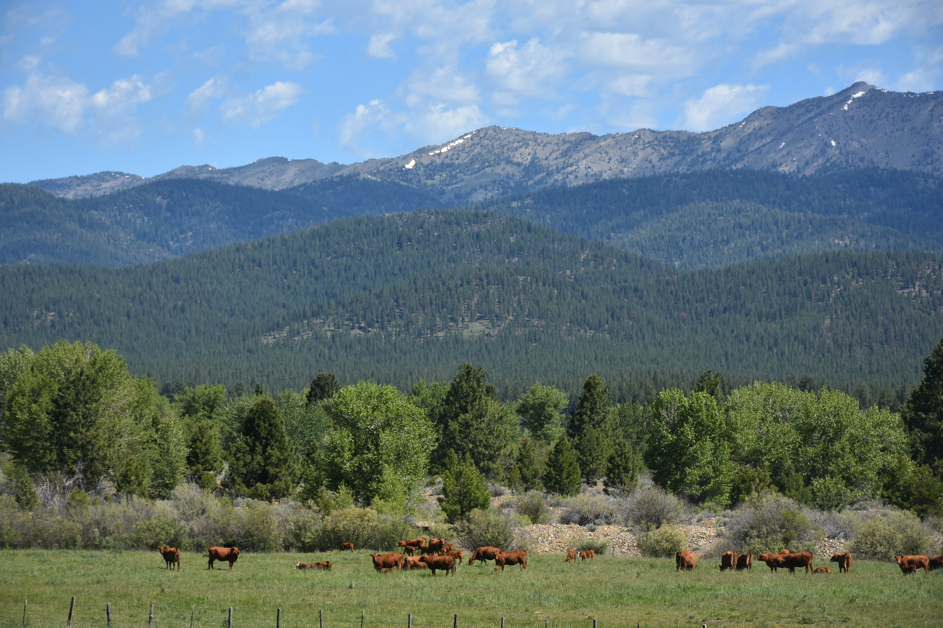
Objectives
Educate on OTEC's Wildfire Mitigation Techniques
Education and Awareness on Public Safety Power Shutoffs
Hear from OTEC Member-Owners

Slide 5

Wildfire Mitigation Is Safety...
Safety has always been priority number one at OTEC.
Wildfire Mitigation is nothing new, but here is a little background.

Slide 6
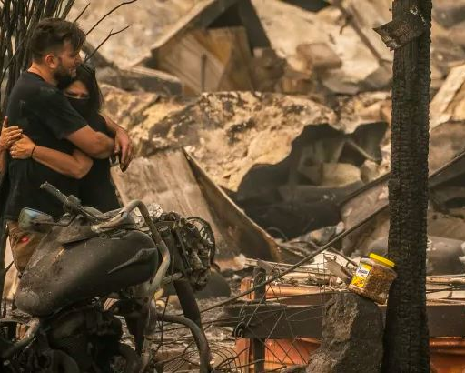
Oregon Wildfires since 2020
600,000 Acres Burned
At least 14 People Killed
More than 435 Houses Destroyed

Slide 7
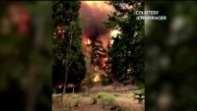

Slide 8
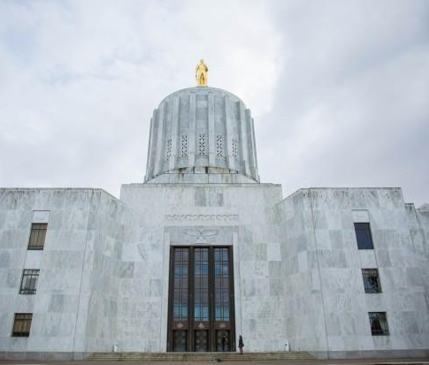
Senate Bill 762
Oregon’s comprehensive wildfire mitigation strategy.
Covers forest management, building codes, utilities, and more.
We have complied - not just because we have to, but because safety is always top of mind. Updates to

Slide 9

Rules and Regulations
OPUC Regulations are tighter for investor-owned utilities than they are for electric cooperatives like OTEC.
We are member driven, with member oversight.

Slide 10
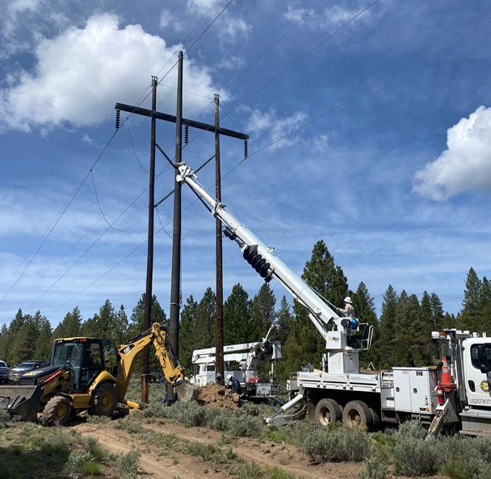
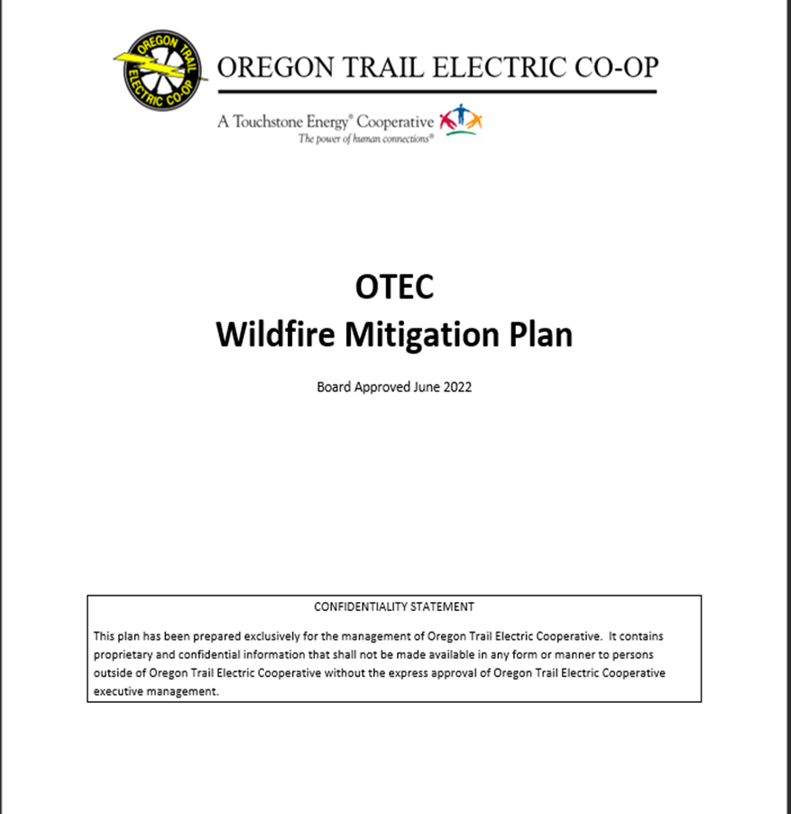
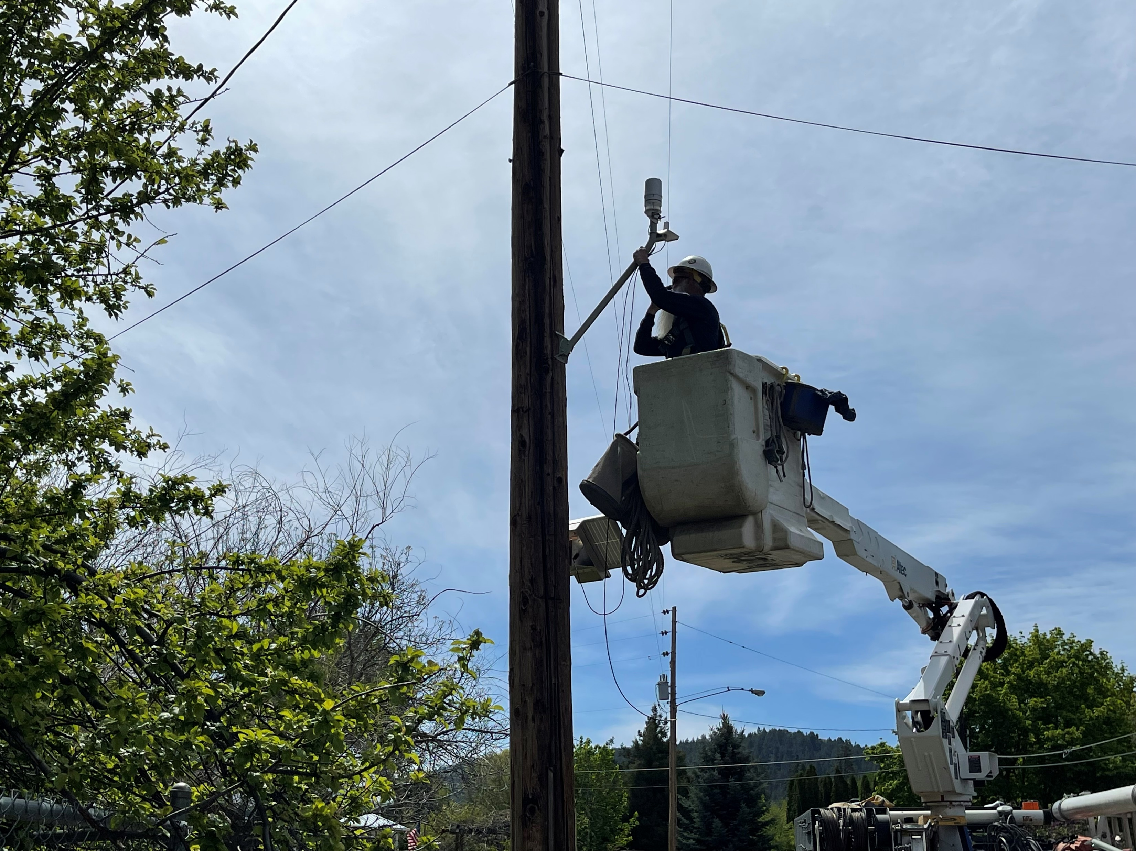

Situational Awareness
Strategic Programs
System Hardening
Preemptive Action
Wildfire Plan
Key Components
Notes:
Installing Weather Stations to Monitor Weather Conditions
OTEC has been prudent with wildfire mitigation since its inception.
Efforts include:
Year-round vegetation management
Frequent system inspections
Increased protection system sensitivity
Post outage patrol
Hardening our system by undergrounding lines
Replacing some poles with fire-resistant poles
Replacing expulsion fuses with sparkless fuses

Slide 11

OTEC Wildfire Mitigation Plan
Development
Responsible Utility Practices
Industry Best Practices
Advancing Technology
High Risk Fire Areas

Slide 12

OTEC Wildfire Mitigation Plan
Situational Awareness
System Risk Assessment
Seasonal Risk Modeling
Operational Practices
More sensitive protective settings
Replace Fuses
Operational Strategies
System Hardening
Enhanced Inspections/Accelerated corrections
Enhanced Vegetation Management
System Improvements
Notes:
velopment
High Risk Fire Areas
Responsible Utility Practices
Industry Best Practices
Advancing Technology

Slide 13
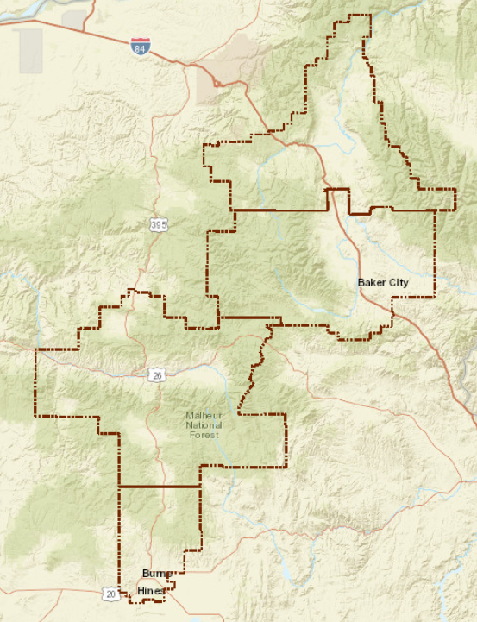
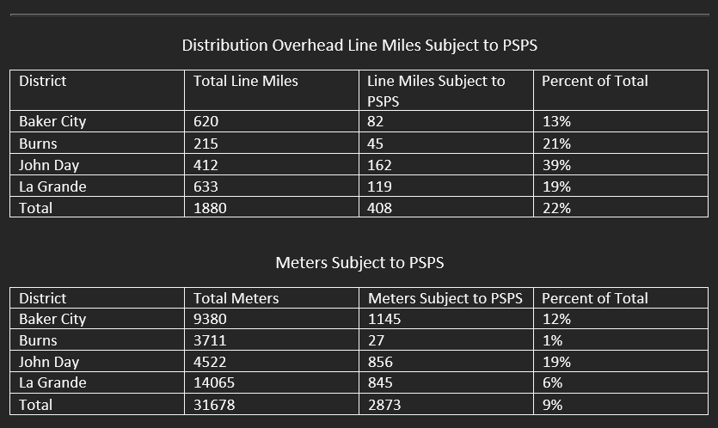
OTEC System Overview
General Stats
OTEC serves over 31,000 meters via over 20 substations, 2200 miles of distribution lines (primary/secondary), and over 700 transmission lines across over 6000 square miles.
Notes:
Meters
BAKER 9510
BURNS 3727
JOHN DAY 4563
LA GRANDE 14220

Slide 14
Overview and General Summary
OTEC has been prudent with wildfire mitigation since its inception.
Efforts include:
  Year-round vegetation management
  Frequent system inspections
  Increased protection system sensitivity
  Post outage patrol
  Hardening our system by undergrounding lines
  Replacing some poles with fire-resistant poles
  Replacing expulsion fuses with sparkless fuses
Notes:
Operations Slide

Slide 15
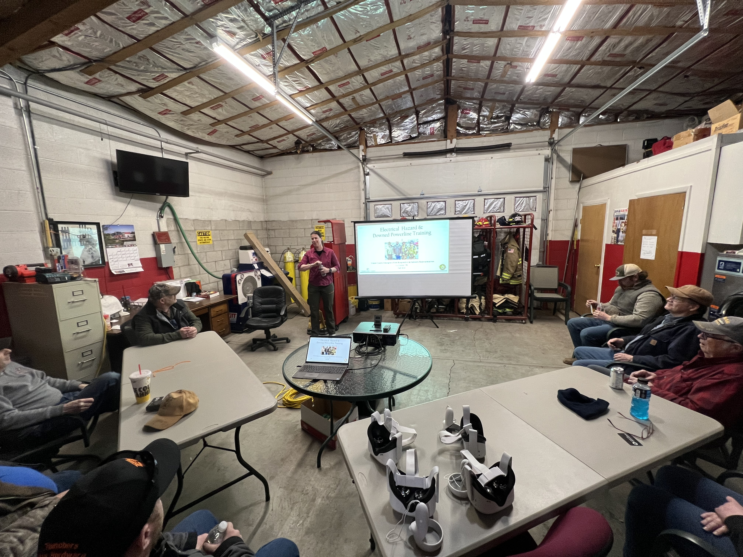
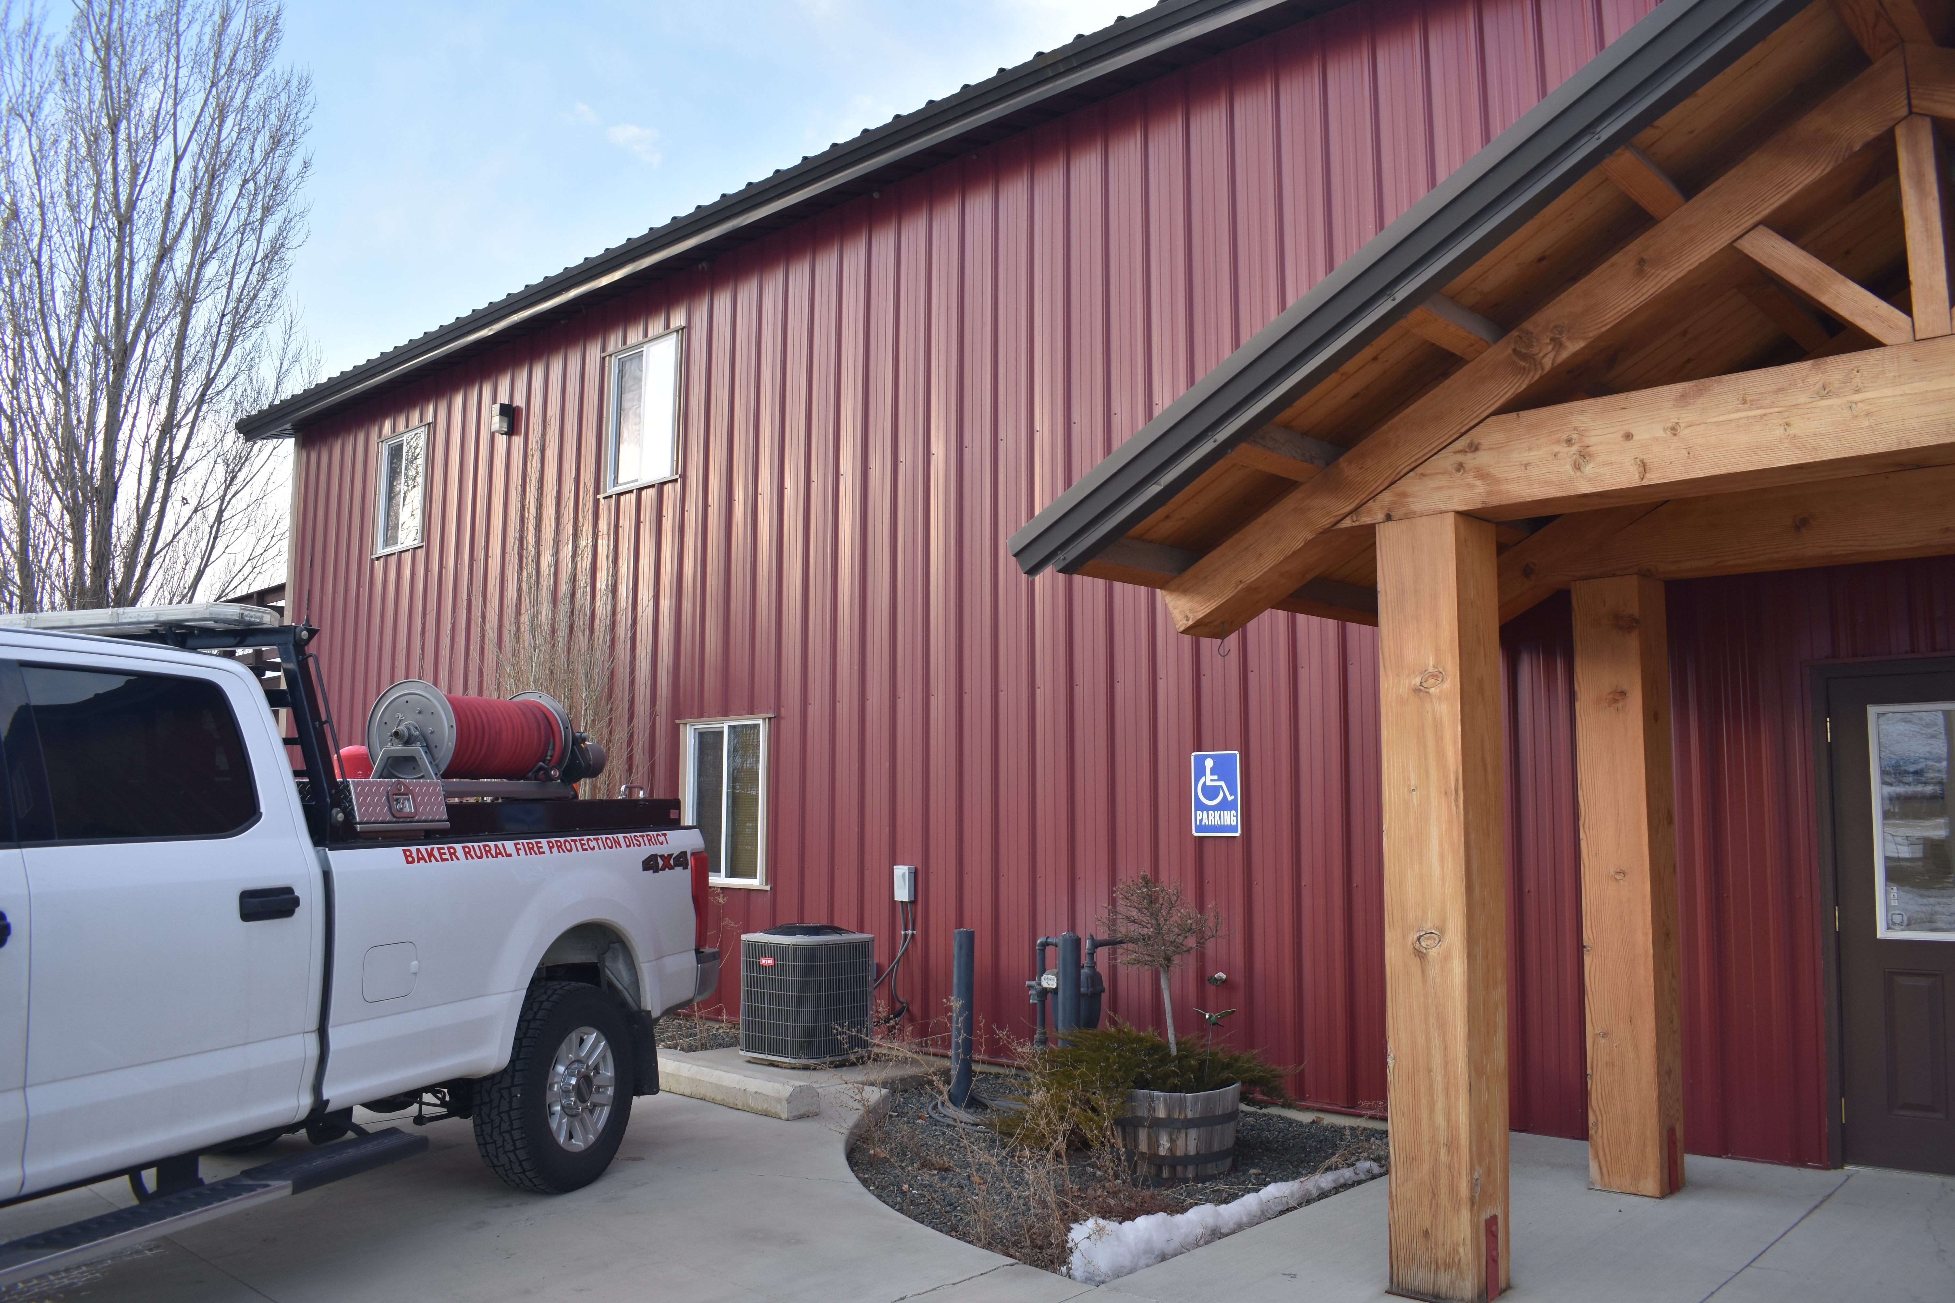
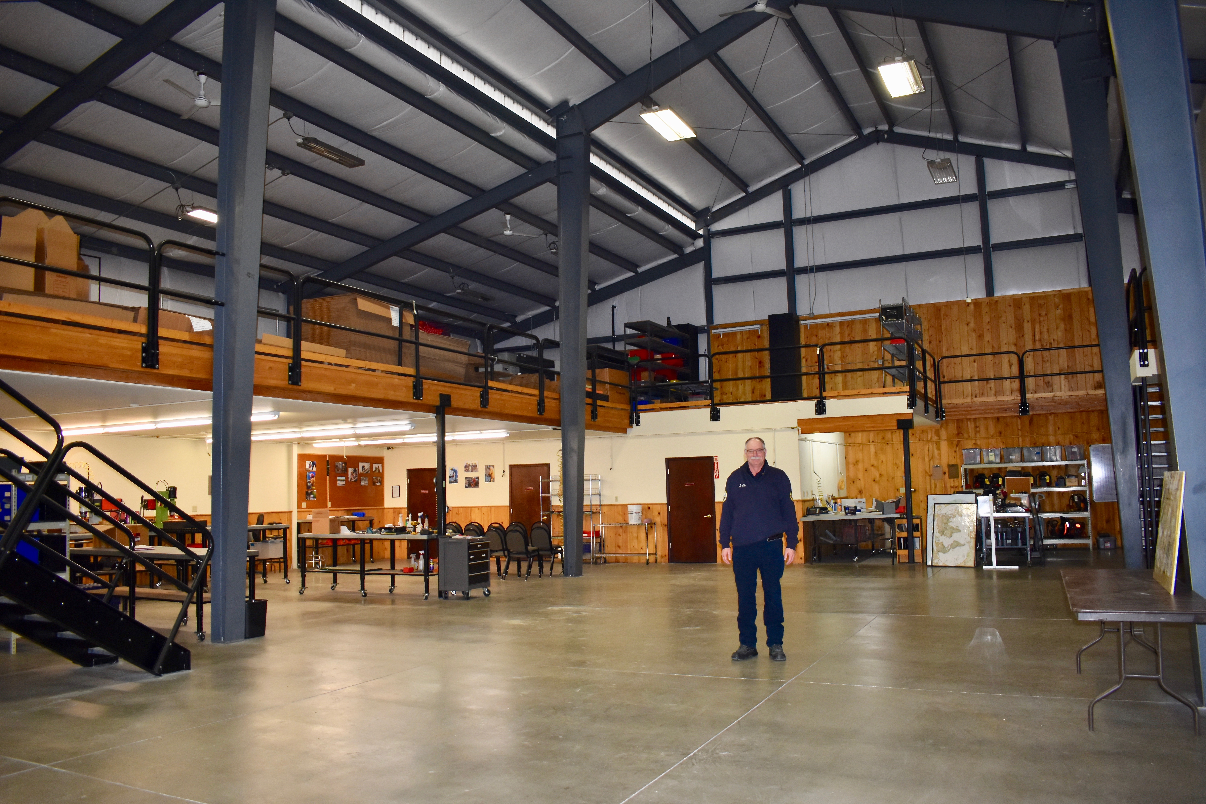
Overview and General Summary
Coordinate and collaborate with local rural fire departments, including sharing mapping data of high fire risk areas.
OTEC is not regulated by OPUC but strives to execute best utility practices by expanding our wildfire mitigation plan and strategies.
Notes:
OTEC has been prudent with wildfire mitigation since its inception.
Efforts include:
Year-round vegetation management
Frequent system inspections
Increased protection system sensitivity
Post outage patrol
Hardening our system by undergrounding lines
Replacing some poles with fire-resistant poles
Replacing expulsion fuses with sparkless fuses

Slide 16
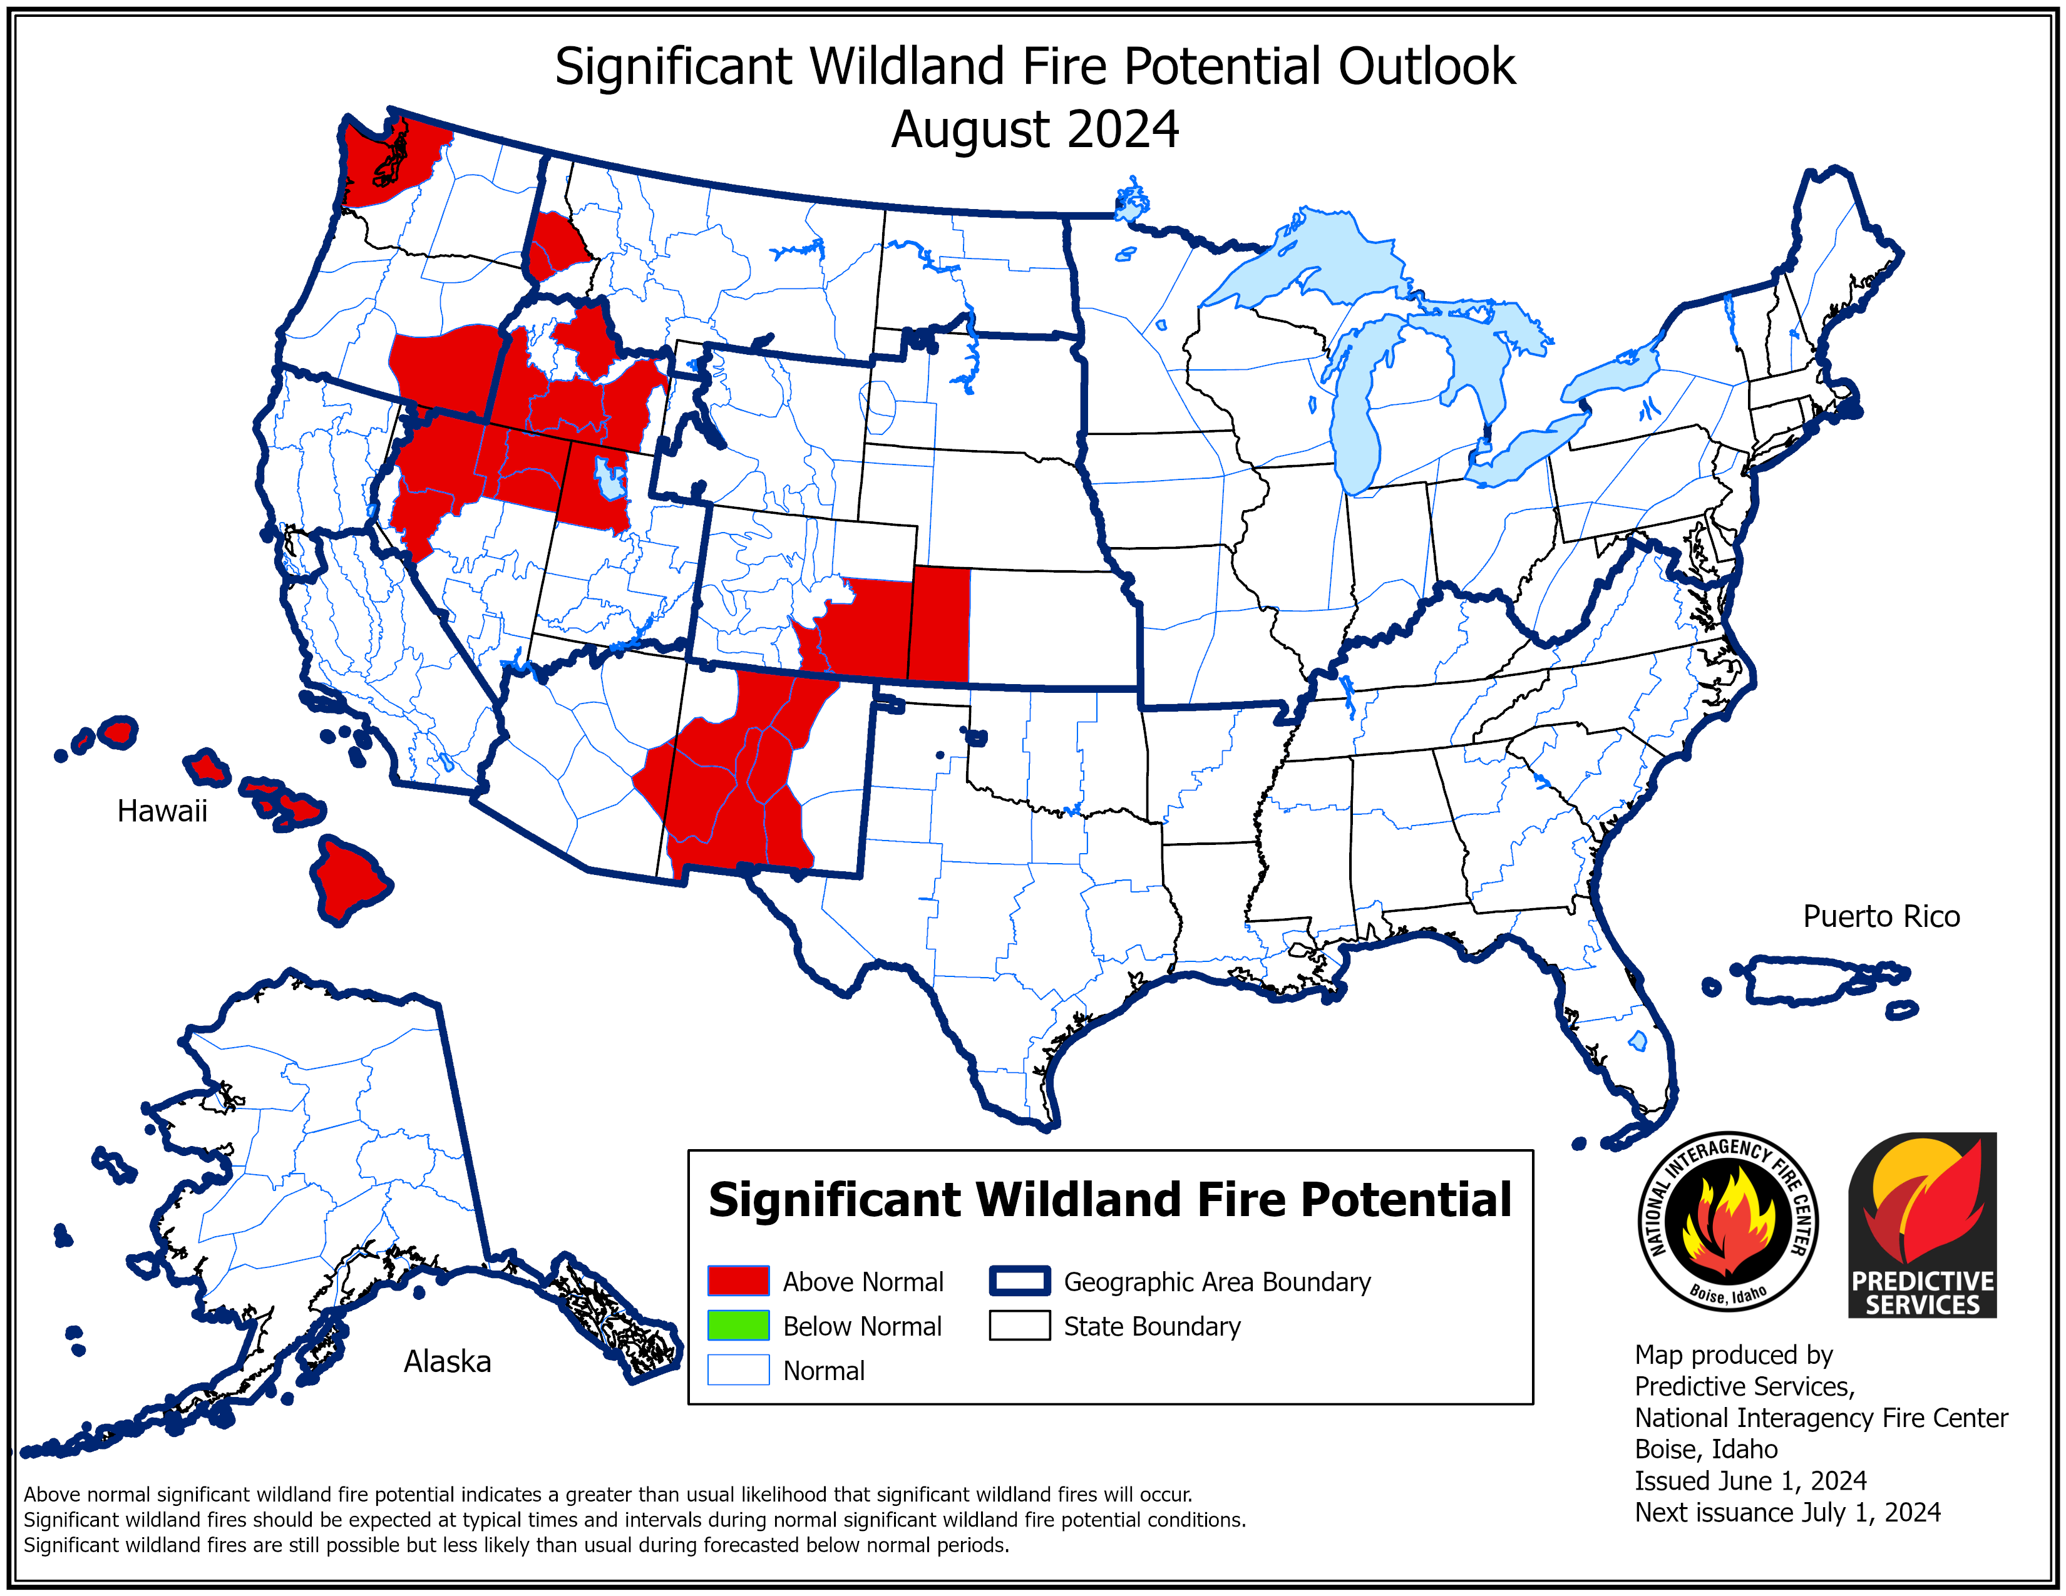
Wildfire
Outlook
2024

Slide 17
Public Safety Power Shutoffs
Notes:
Not taken lightly. Our mission is to provide reliable service. Constant analysis to strike a balance between risk and service.

Slide 18
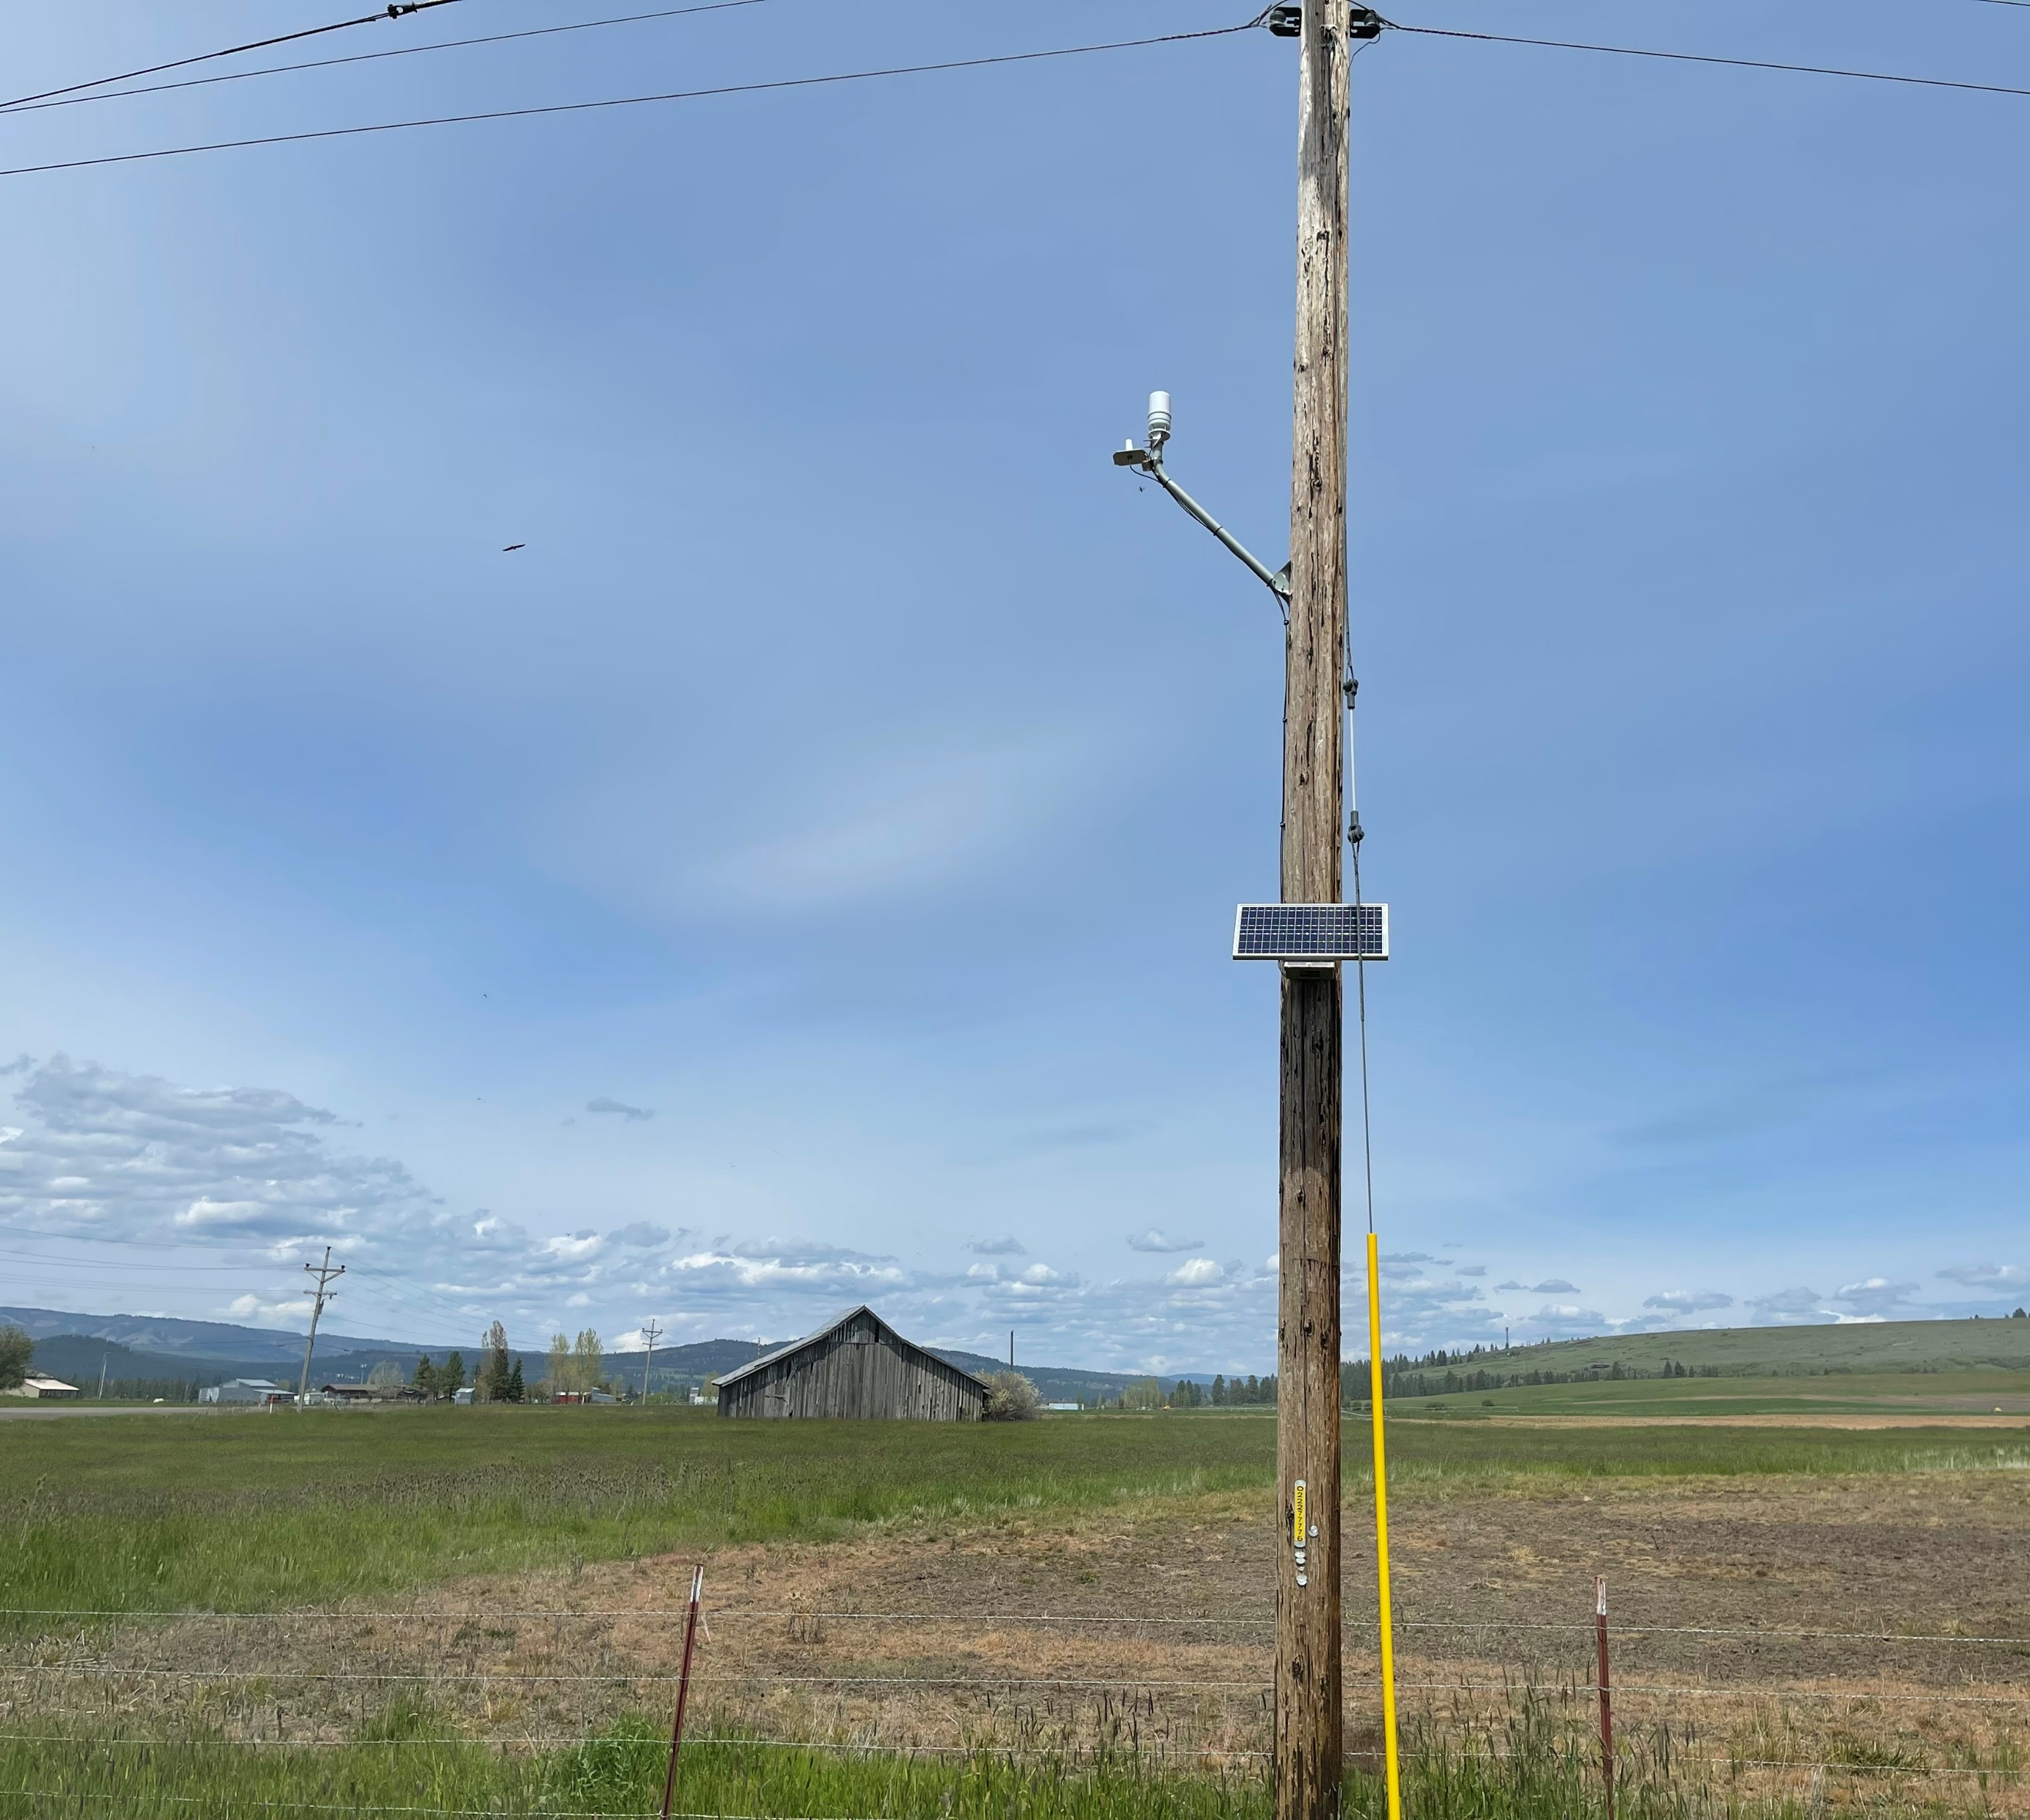
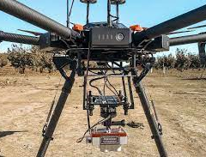
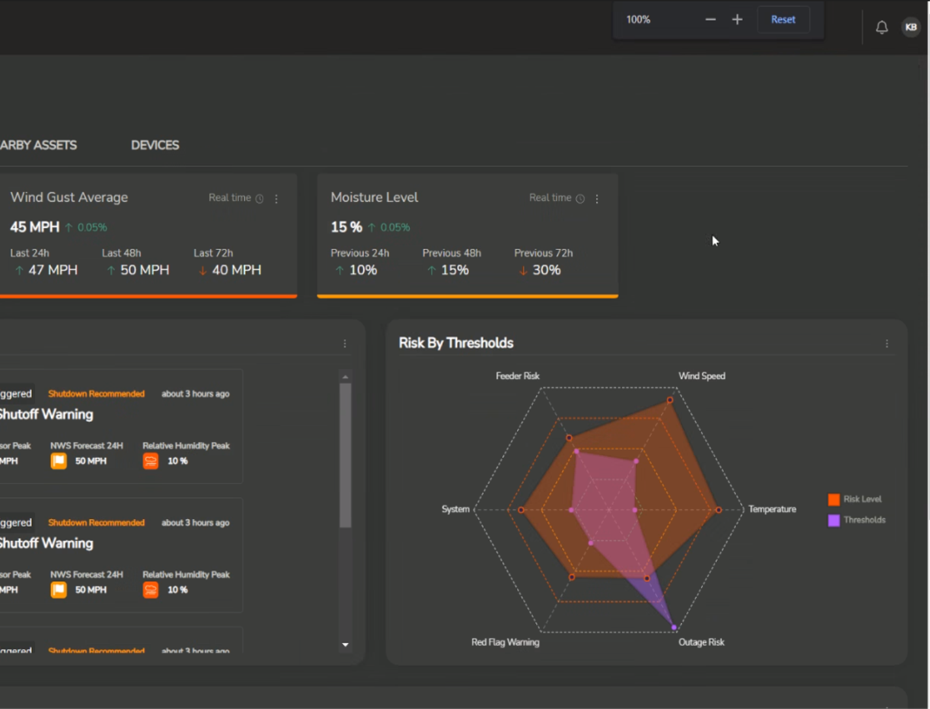
Public Safety Power Shutoffs
Preemptive Action
Extreme Weather Conditions
Select Designated High Risk Fire Area
Last Resort
NOT Rolling Blackouts
Notes:
Preemptive Action to Deenergize Powerlines During Extreme Weather Conditions
Power Supplier
An operational practice OTEC may use to shut off power in high-risk fire areas to reduce fire risk during extreme and potentially dangerous weather conditions.
Extreme circumstances: Red Flag Warnings, sustained gusts of 50+ mph, low humidity, ground conditions, urgency of fire threat.
A Public Safety Power Shutoff is a last resort measure that will occur ONLY IF circumstances on the ground require it for safety of the communities OTEC serves. They are not part of any load reduction program.

Slide 19

Public Safety Power Shutoffs
Communications
  72-24 Hour Notice: Calls, texts, emails
  Coordination with emergency management
Continuous communication with members in affected areas
Preparation is key, as every inch of affected line needs to be inspected.
Members with medical needs should proactively contact emergency services
OTEC’s website includes a list of additional resources to help everyone prepare for wildfires and outages.
Please sign up for Union County Emergency Warning System
Notes:
Monitoring
Communications
72-24 Hour Notice: Calls, texts, emails
Coordination with emergency management
Continuous communication with members in affected areas
Preparation is key, as every inch of affected line needs to be inspected.
Members with medical needs should proactively contact emergency services
OTEC’s website includes a list of additional resources to help everyone prepare for wildfires and outages.

Slide 20
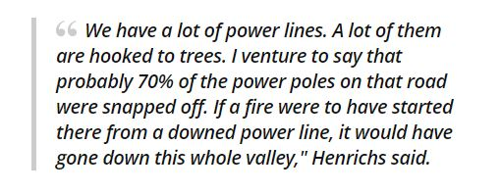
Public Safety Power Shutoffs
Notes:
Monitoring
Communications
72-24 Hour Notice: Calls, texts, emails
Coordination with emergency management
Continuous communication with members in affected areas
Preparation is key, as every inch of affected line needs to be inspected.
Members with medical needs should proactively contact emergency services
OTEC’s website includes a list of additional resources to help everyone prepare for wildfires and outages.

Slide 21
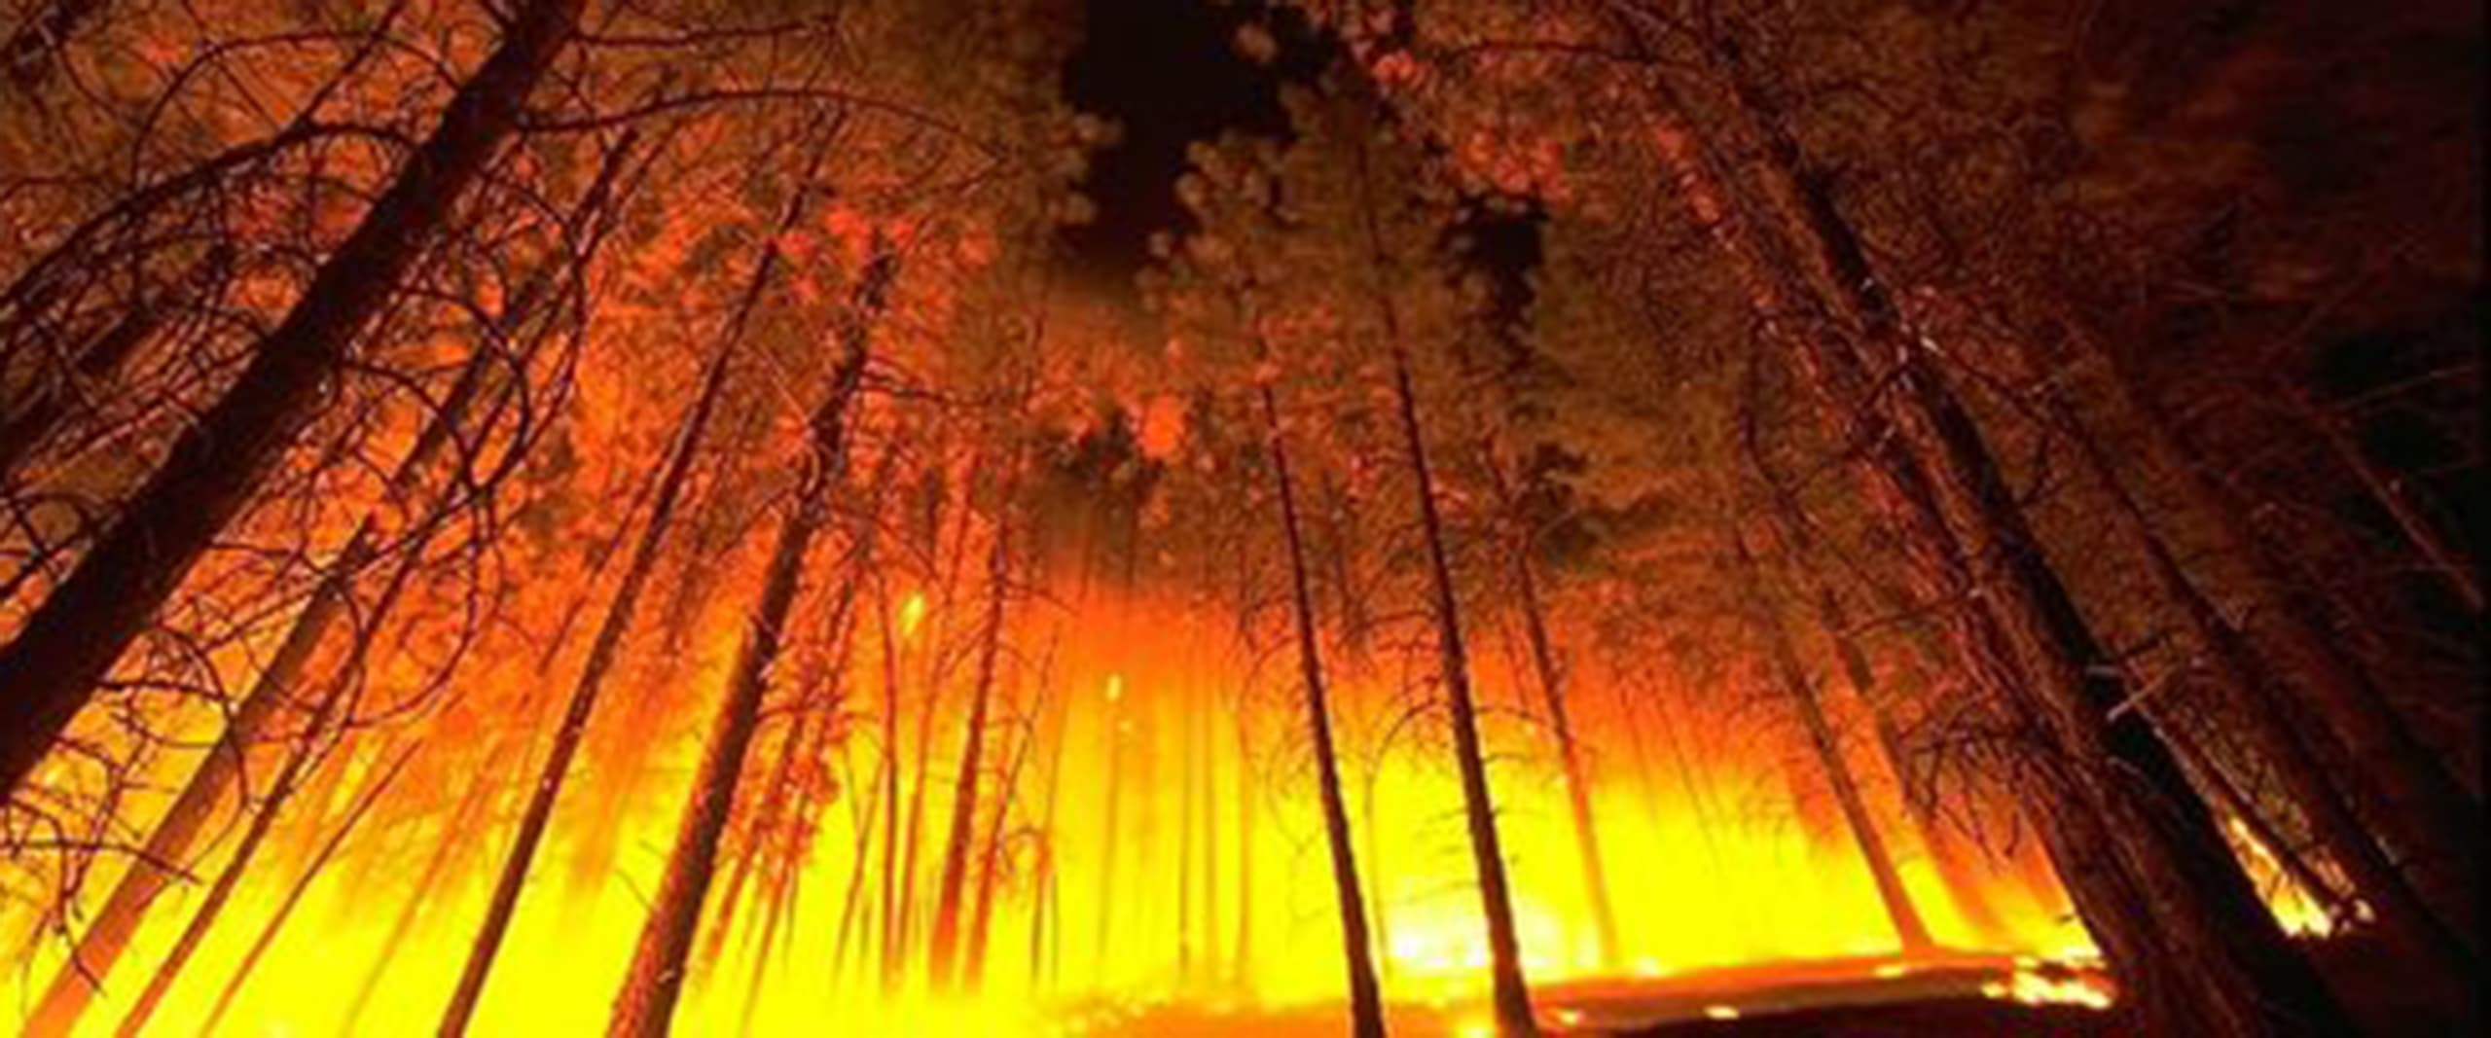
QUESTIONS?
More Information on www.otec.coop
Please email communications@otec.coop

